Slide 2
CDS Resources for Week 1
Install R
Install R Studio
International Stroke Trial - Data
International Stroke Trial Database

Slide 3
Course Overview
Describe, Compare, Predict Framework
What is your research question?
PICOT
Linking study design to research question
Overview of study designs

Slide 4
Describe, Compare, Predict (DCP)
Describe
Compare
Predict
Table with three columns, students fill the table with research questions

Slide 5
What is your research question?
Population
Intervention
Control
Outcome
Time

Slide 6
PICOT
Basic vs. applied research
Quantitative vs. qualitative research
Observational vs. experimental research

Slide 7
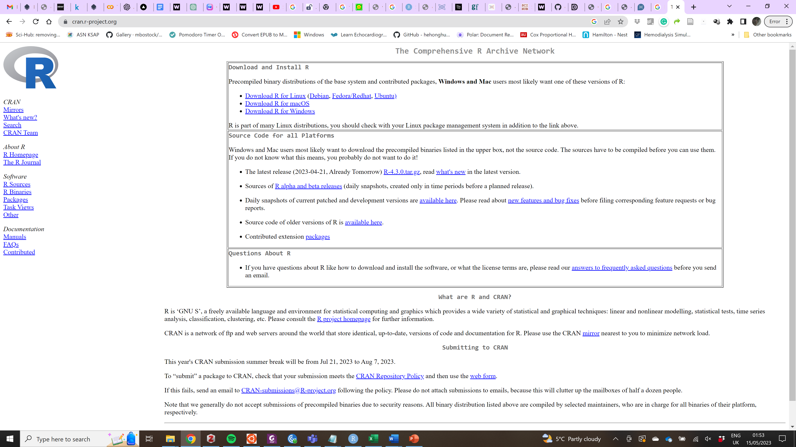
Install R
alt_text

Slide 8
Introduction to RStudio
https://swcarpentry.github.io/r-novice-gapminder/01-rstudio-intro.html

Slide 9
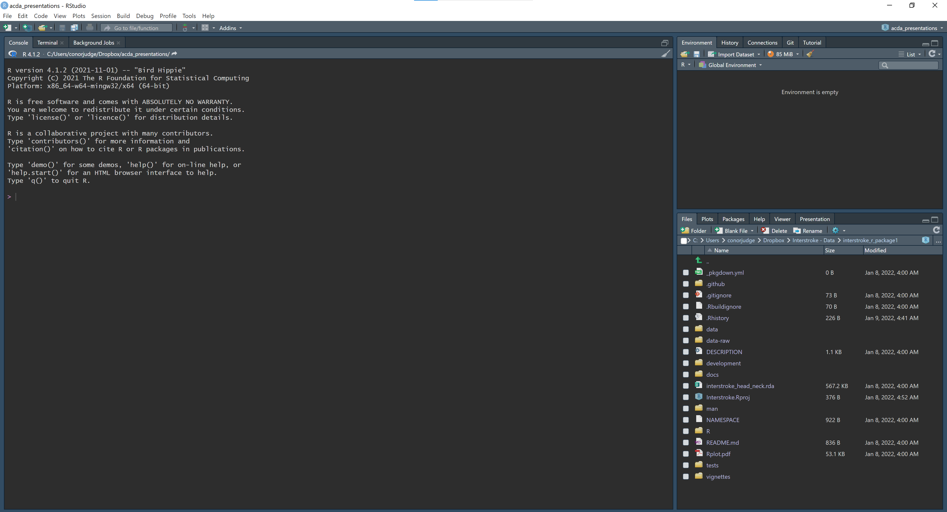
Basic layout
Rstudio Basic Layout

Slide 10
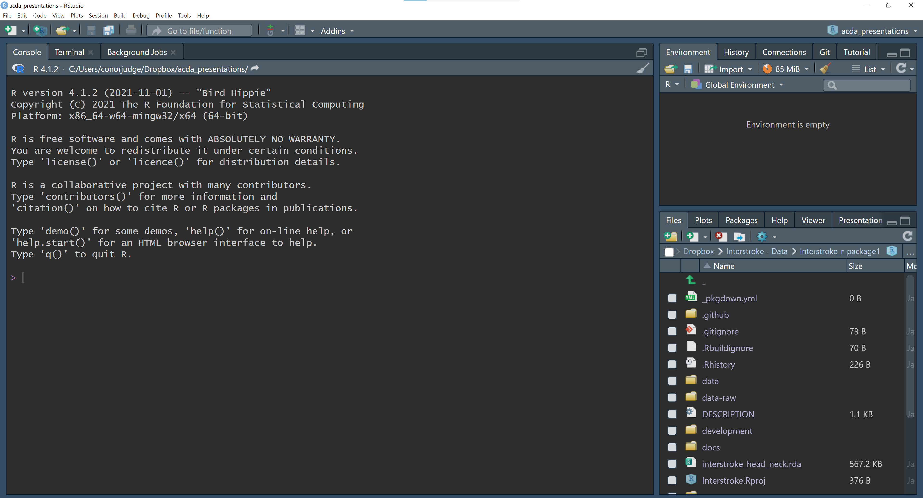
The interactive R console (entire left)
Interactive R Console (Zoomed)

Slide 11
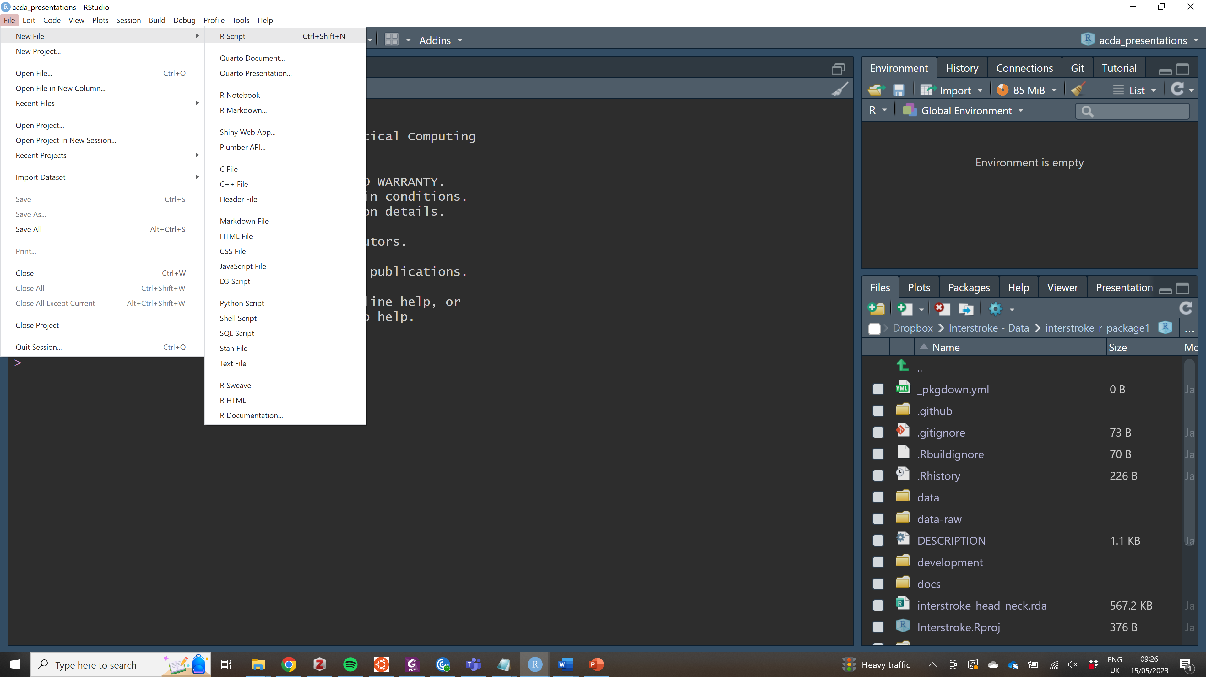
Create a new R script
alt_text

Slide 12
Environment/History/Git/Connections (tabbed in upper right)

Slide 13
Files/Plots/Packages/Help (tabbed in lower right)

Slide 14
R Script Editor

Slide 15
.R Files

Slide 16
Running Code in R Studio
Run Button
Run Lines
Ctrl + Return

Slide 17
Comparing things
1 == 1
1 != 2
1 < 2
1 <= 2
1 > 0

Slide 18
Variables and assignment
x <- 1+2

Slide 19
Variable Names

Slide 20
R Packages

Slide 21
Good Enough Practices for Scientific Computing
Put each project in its own directory, which is named after the project.
Put text documents associated with the project in the doc directory.
Put raw data and metadata in the data directory, and files generated during cleanup and analysis in a results directory.
Put source for the project’s scripts and programs in the src directory, and programs brought in from elsewhere or compiled locally in the bin directory.
Name all files to reflect their content or function.

Slide 22
Working directory
getwd()
setwd()

Slide 23
Version Control

Slide 24
R Graph Gallery
http://r-graph-gallery.com/

